Slide 1

Title
Notes:
Hi. Welcome to this episode of Emergent Nature.
My name is J Mark Morris. I go by Mark.
In this episode I’ll discuss the error that caused science to go off track into general relativity and quantum mechanics.
That may seem like an unusual thing to say, since general relativity and quantum theory are generally considered to be successful effective theories.
However, as we will see, an error circa 1900 threw science off track.
There is a parsimonious solution to nature.

Slide 2
Colors
#8F00FF
ELECTRIC_PURPLE
#4B0082
INDIGO
# 47015D
DEEP_PURPLE
#6A0DAD
TRUE_PURPLE
#7030A0
PPT purple
#710193

Slide 3
 |  |  |  |  |  |  |  |  |  | 4,4 |  |  | 7,4
 |  |  |  |  |  |  |  |  | 3,3
 |  |  |  |  |  |  | 1,2 | 2,2
 |  |  |  |  |  |  | 1,1
 |  |  |  |  |  | -1,-1
 |  |  |  |  |  |  |  |  |  |  | ELECTRIC PURPLE
 |  |  |  |  |  |  |  |  |  |  |  | #8F00FF
-7,-4
By default, the scene in Manim is made up of an 8 x 14 grid.
The grid is addressed using a numpy array in the form of [x, y, z].
For 2D animations, only the x and y axes are used.
The origin (green dot) corresponds to the coordinates (0, 0, 0) in the numpy array [x, y, z].
This image is helpful as a reference when sizing animation objects

Slide 4
 |  |  |  |  |  |  |  |  |  | 4,4 |  |  | 7,4
 |  |  |  |  |  |  |  |  | 3,3
 |  |  |  |  |  |  | 1,2 | 2,2
 |  |  |  |  |  |  | 1,1
 |  |  |  |  |  | -1,-1
 |  |  |  |  |  |  |  |  |  |  | INDIGO
 |  |  |  |  |  |  |  |  |  |  |  | #4B0082
-7,-4
By default, the scene in Manim is made up of an 8 x 14 grid.
The grid is addressed using a numpy array in the form of [x, y, z].
For 2D animations, only the x and y axes are used.
The origin (green dot) corresponds to the coordinates (0, 0, 0) in the numpy array [x, y, z].
This image is helpful as a reference when sizing animation objects

Slide 5
 |  |  |  |  |  |  |  |  |  | 4,4 |  |  | 7,4
 |  |  |  |  |  |  |  |  | 3,3
 |  |  |  |  |  |  | 1,2 | 2,2
 |  |  |  |  |  |  | 1,1
 |  |  |  |  |  | -1,-1
 |  |  |  |  |  |  |  |  |  |  |  | #710193
-7,-4
By default, the scene in Manim is made up of an 8 x 14 grid.
The grid is addressed using a numpy array in the form of [x, y, z].
For 2D animations, only the x and y axes are used.
The origin (green dot) corresponds to the coordinates (0, 0, 0) in the numpy array [x, y, z].
This image is helpful as a reference when sizing animation objects

Slide 6
 |  |  |  |  |  |  |  |  |  | 4,4 |  |  | 7,4
 |  |  |  |  |  |  |  |  | 3,3
 |  |  |  |  |  |  | 1,2 | 2,2
 |  |  |  |  |  |  | 1,1
 |  |  |  |  |  | -1,-1
 |  |  |  |  |  |  |  |  |  |  |  | #7030A0
-7,-4
By default, the scene in Manim is made up of an 8 x 14 grid.
The grid is addressed using a numpy array in the form of [x, y, z].
For 2D animations, only the x and y axes are used.
The origin (green dot) corresponds to the coordinates (0, 0, 0) in the numpy array [x, y, z].
This image is helpful as a reference when sizing animation objects

Slide 7
GR/QM/LCDM content (the past)
16 : 9 landscape orientation
clips of outreach videos
slide images
animations
Wikipedia or web pages
NPQG future
portrait
head
shoulders
hands
statements
mathematics

Slide 8
Neoclassical.ai
16 : 9 landscape orientation
clips of outreach videos
slide images
animations
Wikipedia or web pages
NPQG future
portrait
head
shoulders
hands
statements
mathematics

Slide 9
16 : 9 landscape orientation
clips of outreach videos
slide images
animations
Wikipedia or web pages
portrait
head
shoulders
hands
statements, mathematics, credits, titles, my own ads, urls, etc.

Slide 10
head
shoulders
hands
16 : 9 orientation
clips of outreach videos
or slides
geometry
visualization
statements
mathematics

Slide 11
geometry
visualization
16 : 9 orientation
clips of outreach videos
head
shoulders
hands
statements
mathematics

Slide 12
Thank You
Questions?

Slide 13
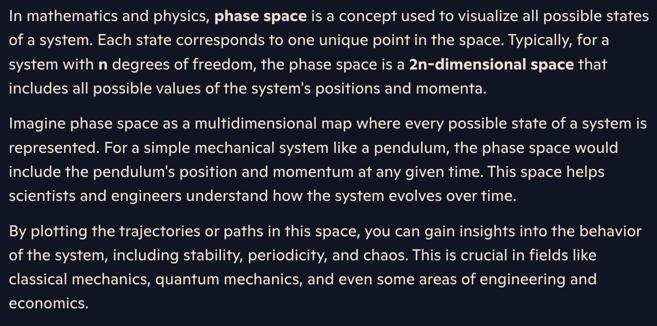
Manim animation in 3D
How might we display phase space?
x, y, z, x’, y’, z’, t is a lot to display visually in an understandable way.
s, s’, t may be difficult to understand since it abstracts a 3D position or velocity onto 1D.
Study Varniex’s YT videos for techniques for animation of paths.
He says he uses ManimGL which is Grant’s version. Will it be compatible or will I need to make a .venv for ManimGL, etc….

Slide 14
Thank You
Questions?

